Slide 2
Intro
Unequal Family Income =
Unequal Opportunity for Higher Education
1990 to 2017
Consortium of State University Aid Administrators
Hotel Maya, Long Beach, CA
April 28, 2019
Tom Mortenson
Senior Scholar
The Pell Institute for the Study of Opportunity in Higher Education

Slide 4
Unequal Family Income = Unequal Opportunity
Family income
Financial barrier trends
Unmet financial need trends
Student work loan burden trends
Net price to family trends
Net price to family tax rate trends
Expected Family Contribution (EFC)
Family income
Expected family contribution
Packaging financial aid
Cost of attendance
Financial need
Grants
Loans
Work-study
Other
Total financial aid

Slide 13
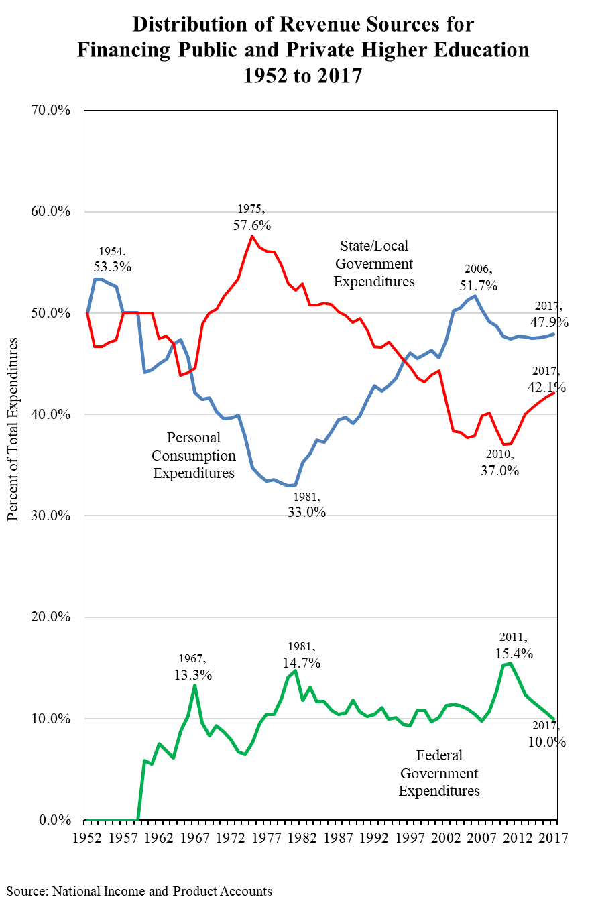

Slide 40
Restoring College Affordability: My recommendations
Federal
$13,000 Pell Grant maximum award
$2,000 Super Pell to fund negative EFC calculated from FAFSA
Universal income contingent education loan repayment
Universal college work-study for all students
States
Require 50:50 match to federal Pell Grant
Institutions
Continued eligibility for Title IV participation contingent on progress toward broadening enrollment of students from low income families

Slide 41
Final
Contact Information:
Email to request PowerPoint from:
tom@postsecondary.org

